Slide 1
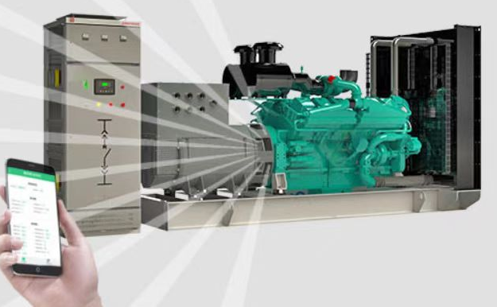
Xinyatong Generator Sets
Laizhou Xinyatong Metal Making Co., Ltd.
Contact: Jiao Mengjiao
Tel: 18505452477

Slide 2

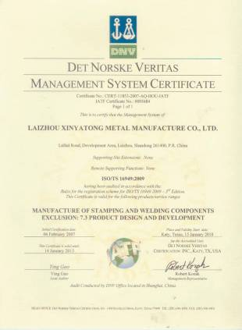
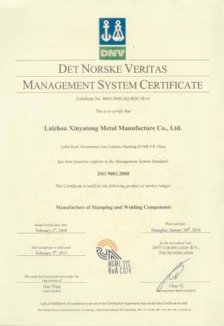
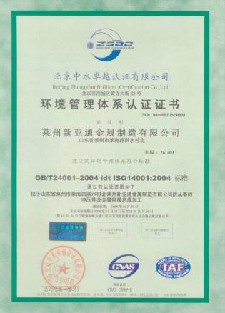
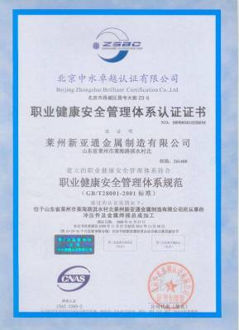
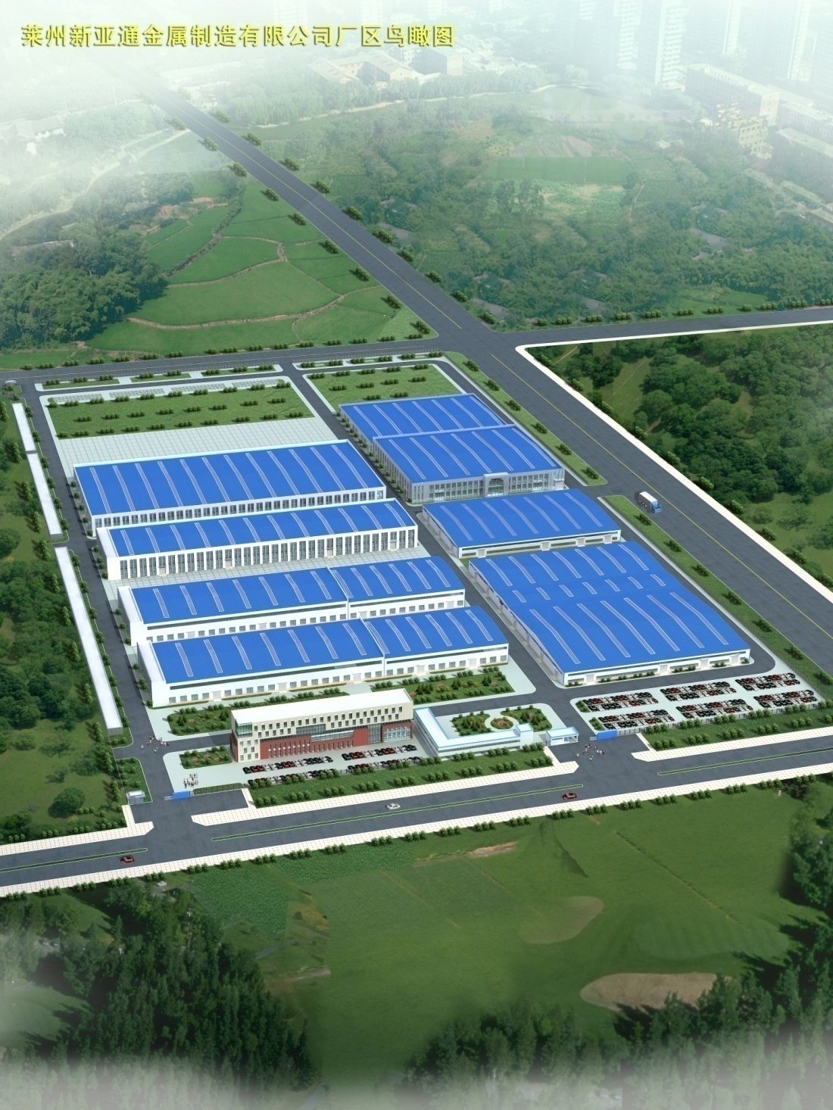
Company Profile
Laizhou Xinyatong Metal Making Co., Ltd. was established on August 12, 2004. Since its inception, the company has consistently adhered to the path of technological innovation, committed to technological advancement, and has maintained a good development momentum.
Superior projects have supported the company's growth speed. The company's main business is the processing and sales of cold-pressed steel products, automotive parts, engine components, aluminum alloy die-castings, molds, standard parts, and generator sets. The main service targets currently include: SAIC Motor Corporation Limited, SAIC General Motors Co., Ltd., SAIC Motor Passenger Vehicle Co., Ltd., SAIC Motor Commercial Vehicle Co., Ltd., Sinotruk Jinan Truck Co., Ltd., FAW Jiefang Automotive Co., Ltd., FAW Jiefang Qingdao Automotive Co., Ltd., Great Wall Motor Company Limited, etc.
Laizhou Xinyatong
1
Good Products
The production of Laizhou Xinyatong generator sets is located in the Yatong Precision Industrial Park, covering an area of 3000 square meters. It is equipped with advanced technology research and development and experimental facilities, with an annual production capacity of up to 1000 generator sets. The power range covers 10-1000KW, equipped with internationally renowned brand engines and generators. The production process is strictly controlled, and tests are strictly conducted in accordance with the GB/T2820 standard. They can be used as fixed power sources or emergency backup power sources. Customers can choose conventional units or low-noise units according to their needs.
Currently, our company mainly produces Weichai, Cummins, Perkins, Yuchai and other series of diesel generator sets, which can be customized to meet the needs of different scenarios.
2
Precision R&D
CONTENTS
3
Process-Oriented
4
High Quality
5
Winning Service

Slide 3
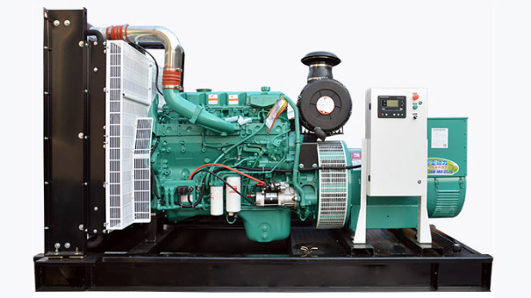
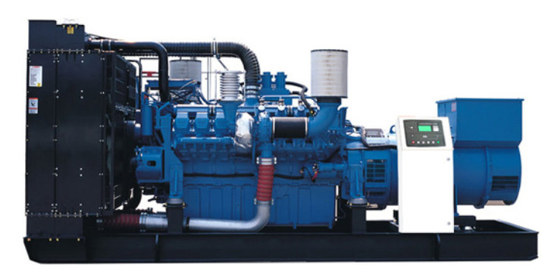
I. Good Products
Xinyatong generator sets are professionally designed, close to customer needs, with high reliability and excellent performance, providing you with an ideal power solution. Xinyatong generator sets have a power range of 10-1000KW, equipped with internationally renowned brand engines and generators. The production process is strictly controlled, and tests are strictly conducted in accordance with the GB/T2820 standard. They can be used as fixed power sources or emergency backup power sources. Customers can choose conventional units or low-noise units according to their needs.
Currently, our company mainly produces Weichai, Cummins, Perkins, Yuchai and other series of diesel generator sets, which can be customized to meet the needs of different scenarios.
Conventional units
Open-type units
Chassis Tank Units

Slide 4
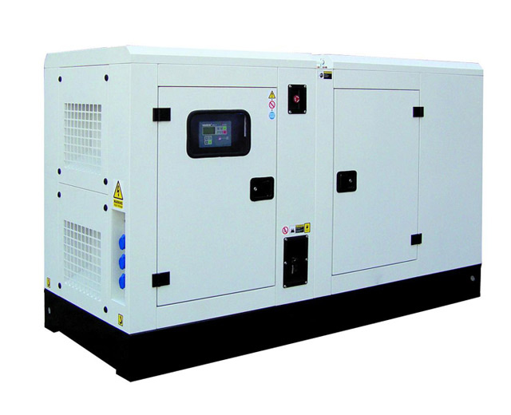
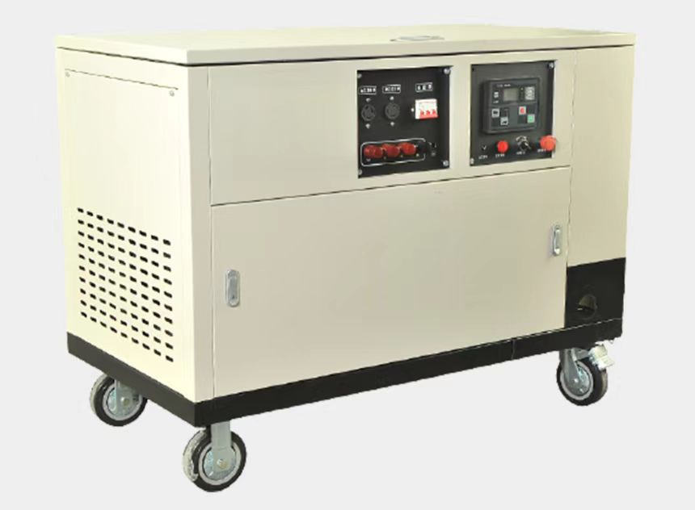
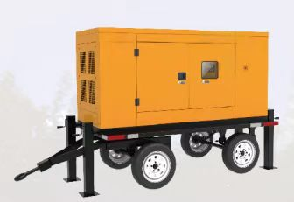
Silent-type Units
Silent Enclosure-type Units
Units with casters
Trailer units
Silent-type units are professionally designed for noise reduction, with features such as easy disassembly and maintenance. The units are integrated with mufflers, fuel tanks, batteries, etc.
High-strength shell, suitable for transportation and outdoor operations, easy to install and relocate.

Slide 5
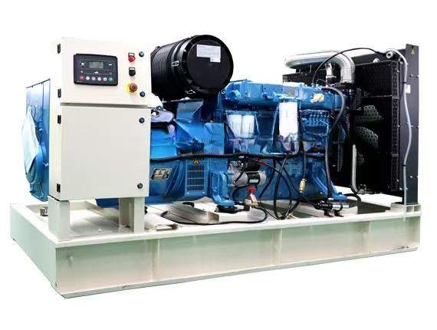
Weichai Brand Generator Set Selection Reference:
Features of Weichai Series Generator Sets:
Stable and reliable performance, low fuel consumption, low emissions, low noise, etc.
The units are wear-resistant, compact in structure, and easy to operate.
Unit model | Standby Power (KVA/KW) | Rated frequency (KVA/KW） | Engine model | Number of cylinders | Bore*stroke (mm) | Dimensions (mm) | Net Weight (Kg）
YT-W400GF | 550/500 | 440/400 | WP13D490E310 | 6 | 127*165 | 3200*1400*1900 | 3200
YT-W500GF | 687/625 | 550/500 | 6M33D633E310 | 6 | 150*185 | 3800*1700*2000 | 5200
YT-W600GF | 825/750 | 660/600 | 6M33D725E310 | 6 | 150*185 | 3800*1700*2000 | 5800
YT-W800GF | 1100/1000 | 880/800 | 8M33D975E310 | 8 | 150*185 | 4000*1900*2100 | 6900
YT-W1000GF | 1375/1250 | 1100/1000 | 12M33D1210E200 | 12 | 150*185 | 4800*2200*2500 | 8400
Note: This spectrum is only for reference in model selection. For specific design parameters, please consult the manufacturer. In case of product modifications or specification improvements, no further notice will be given. The actual product shall prevail.

Slide 6
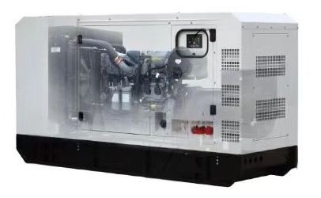
Cummins Generator Set Selection Reference:
Features of Cummins Series Generator Sets:
Strong power, high reliability, good durability, excellent fuel economy, compact size, high power, strong parts commonality, safety and environmental protection, etc.
Unit model | Standby Power (KVA/KW) | Rated frequency (KVA/KW） | Engine model | Number of cylinders | Bore*stroke (mm) | Dimensions (mm) | Net Weight (Kg）
YT-K30GF | 42/33 | 37.5/30 | 4B3.9-G12 | 4 | 102*120 | 1700*700*1200 | 900
YT-K60GF | 85/68 | 75/60 | 4BTA3.9-G11 | 4 | 102*120 | 1900*800*1500 | 1180
YT-K100GF | 140/112 | 125/100 | 6BTA5.9-G2 | 6 | 102*120 | 2250*880*1540 | 1500
YT-K400GF | 550/440 | 500/400 | KTA19-G3A | 6 | 159*159 | 3500*1400*2200 | 4600
YT-K800GF | 1100/880 | 1000/800 | KTA38-G5 | 12V | 159*159 | 4400*1820*2450 | 7900
Note: This spectrum is only for reference in model selection. For specific design parameters, please consult the manufacturer. In case of product modifications or specification improvements, no further notice will be given. The actual product shall prevail.

Slide 7
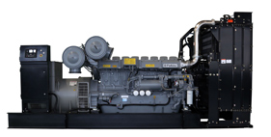
Perkins Generator Set Selection Reference:
Features of Perkins Series Generator Sets:
Low fuel consumption, stable performance, convenient maintenance, low operating costs, low emissions, environmentally friendly and efficient, etc.
Unit model | Standby Power (KVA/KW) | Rated frequency (KVA/KW） | Engine model | Number of cylinders | Bore*stroke (mm) | Dimensions (mm) | Net Weight (Kg）
YT-B100GF | 140/112 | 125/100 | 1106A-70TG1 | 6 | 105*135 | 2250*880*1400 | 1500
YT-B400GF | 550/440 | 500/400 | 2506C-E15TAG2 | 6 | 137*171 | 3500*1150*2050 | 3650
YT-B600GF | 825/660 | 750/600 | 4006-23TAG2A | 6 | 160*190 | 3750*1700*2400 | 5840
YT-B800GF | 1100/880 | 1000/800 | 4008TAG2 | 8 | 160*190 | 4700*2000*2400 | 7800
YT-B1000GF | 1375/1100 | 1250/1000 | 4012-46TAG2A | 12V | 160*190 | 4950*2100*2450 | 11000
Note: This spectrum is only for reference in model selection. For specific design parameters, please consult the manufacturer. In case of product modifications or specification improvements, no further notice will be given. The actual product shall prevail.

Slide 8
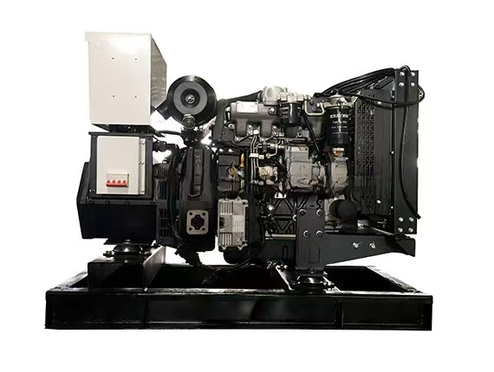
Yuchai Generator Set Selection Reference:
Features of Yuchai Series Generator Sets:
Yuchai is China's most complete and comprehensive internal combustion engine manufacturing base.
Its engines have the advantages of low noise, high horsepower, low fuel consumption, high torque, safe and reliable operation, etc.
Unit model | Standby Power (KVA/KW) | Rated frequency (KVA/KW） | Engine model | Number of cylinders | Bore*stroke (mm) | Dimensions (mm) | Net Weight (Kg）
YT-Y30GF | 42/33 | 37.5/30 | YC4D60-D25 | 4 | 108*115 | 1800*810*1160 | 750
YT-Y50GF | 70/56 | 62.5/50 | YC4D90Z-D25 | 4 | 108*115 | 1950*820*1250 | 930
YT-Y80GF | 110/88 | 100/80 | YC4A140L-D20 | 4 | 108*132 | 2000*900*1320 | 1120
YT-Y150GF | 200/160 | 187.5/150 | YC6A245L-D21 | 6 | 108*132 | 2450*950*1500 | 1730
YT-Y200GF | 275/220 | 250/200 | YC6MK350L-D20 | 6 | 123*145 | 2900*1100*1750 | 2470
Note: This spectrum is only for reference in model selection. For specific design parameters, please consult the manufacturer. In case of product modifications or specification improvements, no further notice will be given. The actual product shall prevail.

Slide 9
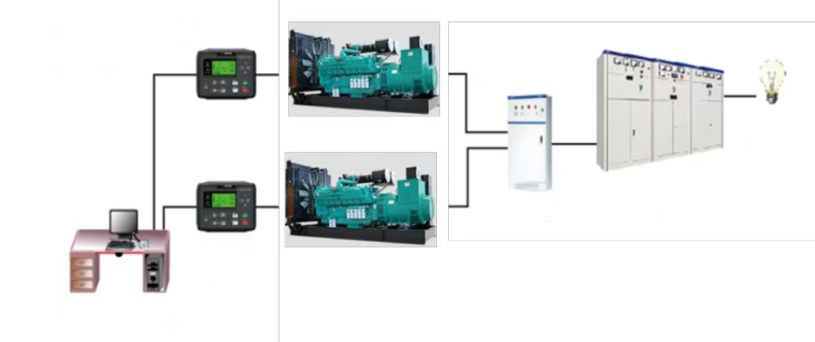
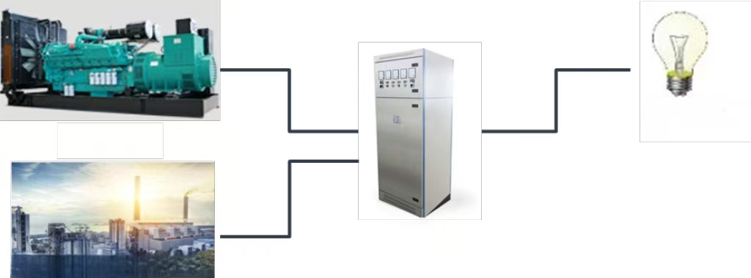
Power Microgrid Technology - Meeting Customers' Personalized Needs
Communication module
Distribution panel
Features of Integration Technology:
Improving the Reliability of Power Supply Systems
More Economical
Highly Scalable
More Convenient and Timely Maintenance
Users Can Customize ATS Transfer Cabinets According to Their Needs
Electrical load
Communication module
Outgoing cabinet
Generator set
Remote Monitoring and Control Software
Electrical load
Generator set
ATS Transfer Cabinet
Trunk Line

Slide 10
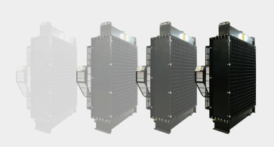
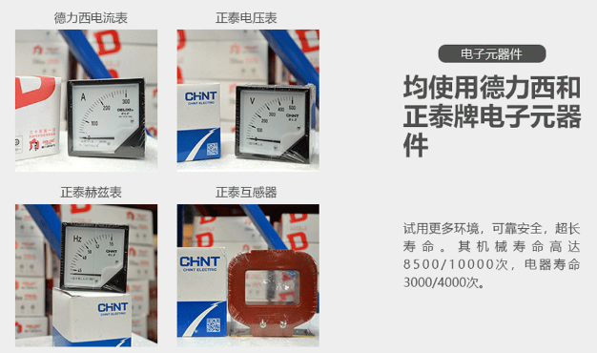
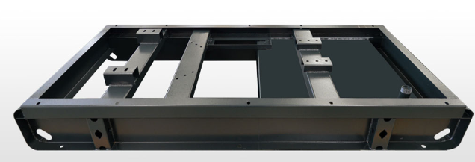
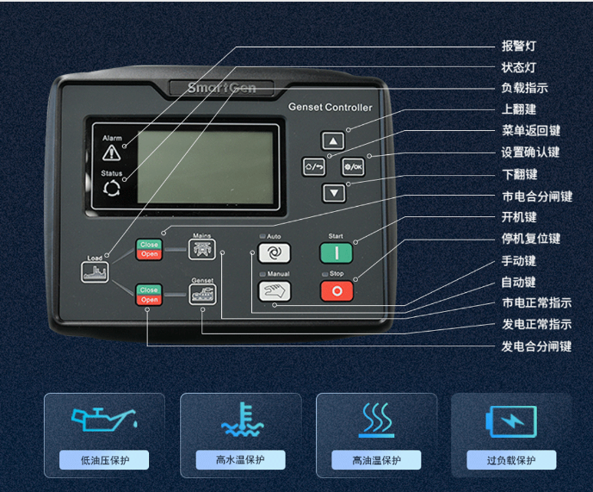
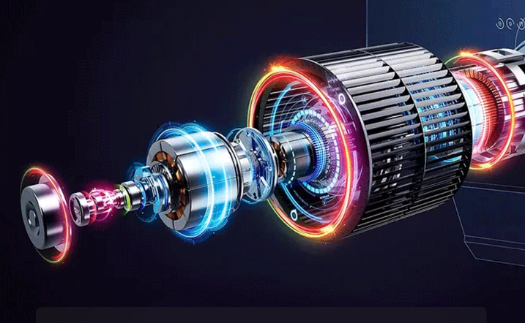
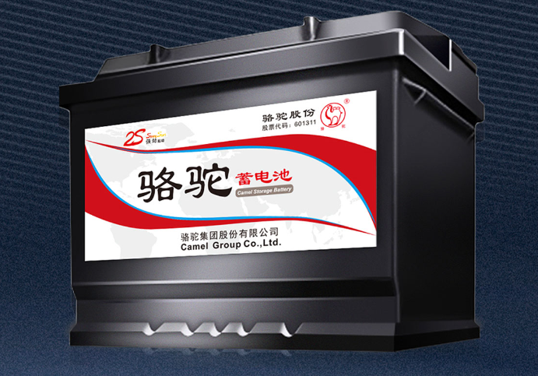
Visible Quality - A Trust, A Guarantee
Integrated cooling protection
Big brand electronic components
High-Strength Chassis
Four protection control system
Pure copper brushless motor
Maintenance-free battery

Slide 11
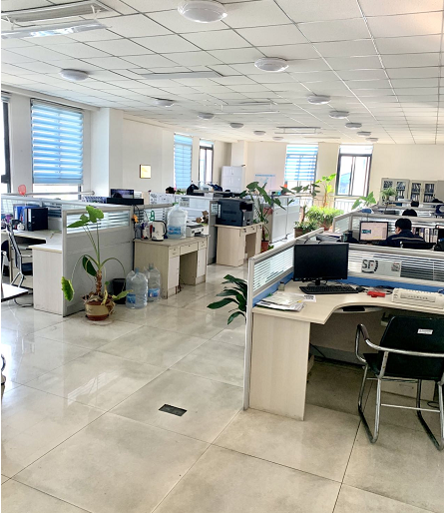
II. Precision R&D
10 engineering and technical development personnel
Personnel status: Engineering technicians have rich experience in assembly product development and debugging, and can carry out customized product development according to customer needs.
Professional technical consultants: 2
Personnel status: With more than 10 years of experience in well-known domestic and foreign generator manufacturers, proficient in the entire process management of generators.

Slide 12
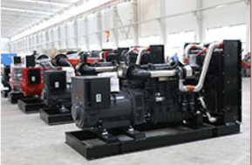
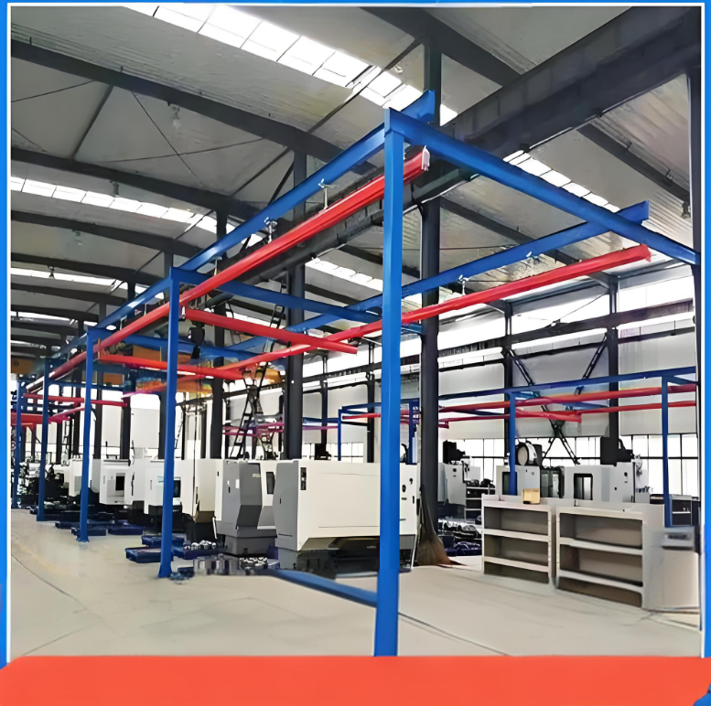
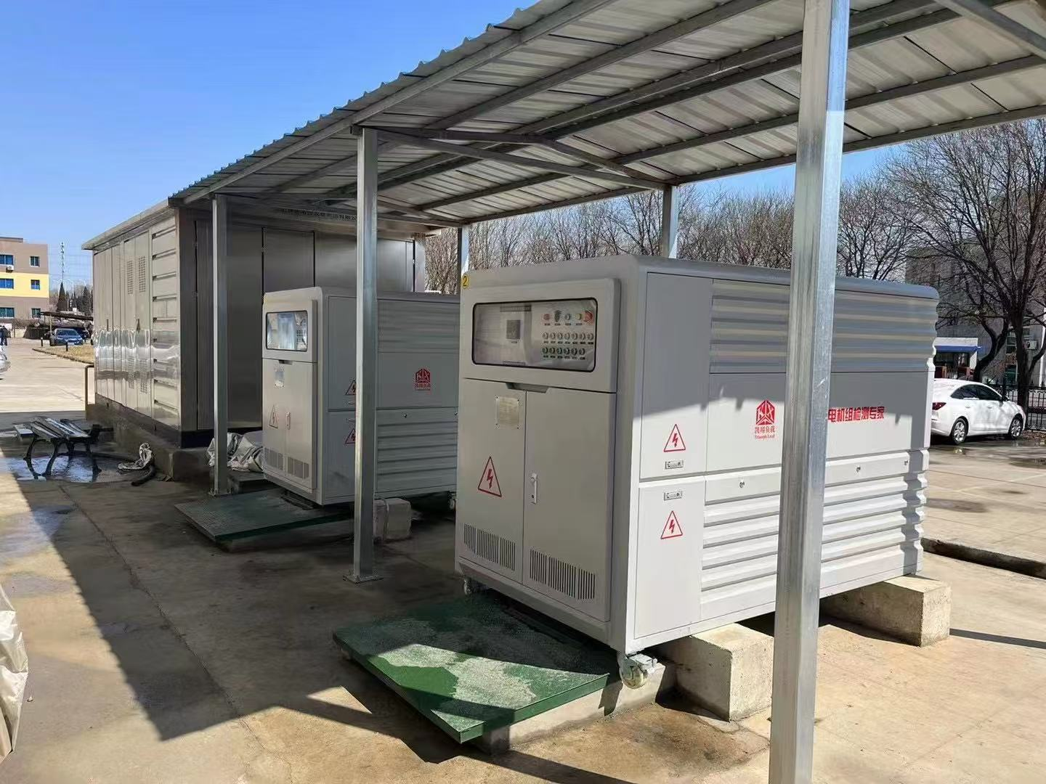
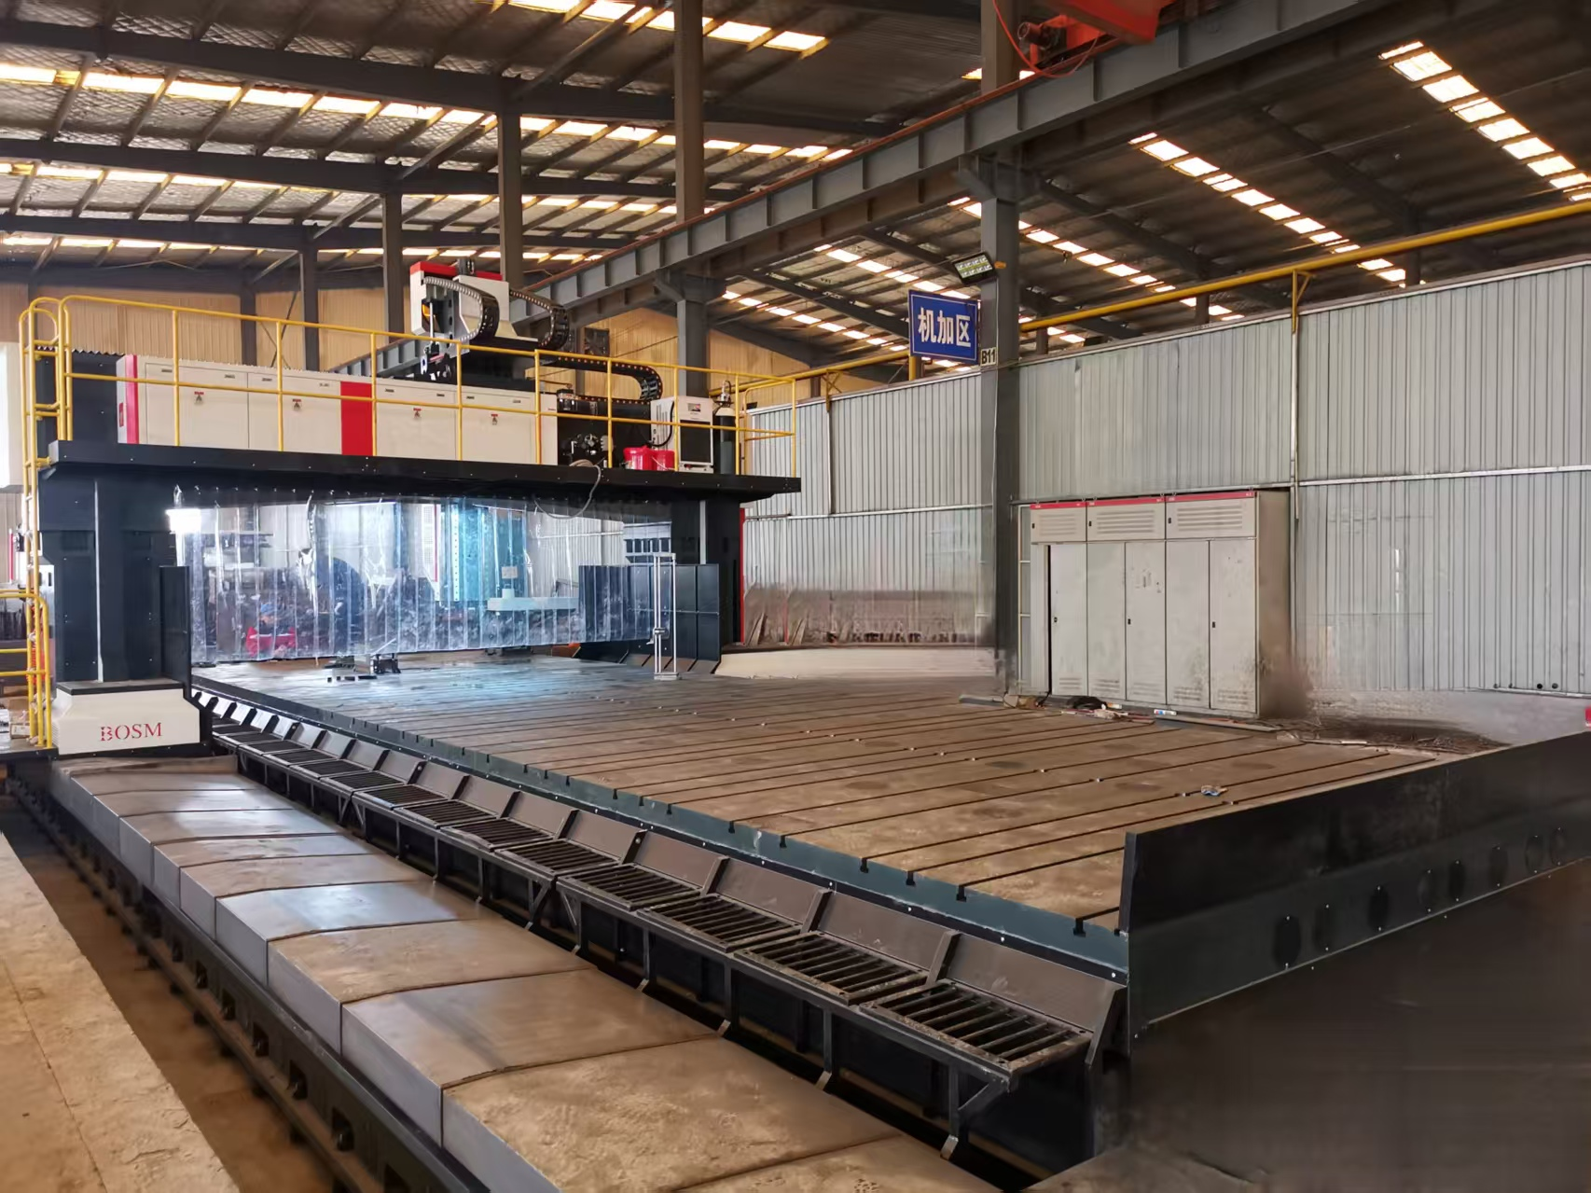
III. Process-Oriented
1. Strong manufacturing capability - Professional production equipment, capable of producing 1000 generators annually
Factory area: 3000 square meters standard factory
Equipment: 16-ton low-track gantry crane
Maximum generator production capacity: 1000KW
1 dedicated production line for small generators
Number of Workstations: 5
Applicable range: Generators below 500KW
Large CNC gantry milling machine
Number of devices: 2 units
Maximum workbench: 12000*4000
Can meet the processing needs of generator set chassis below 2000KW, ensure the processing accuracy of the chassis, and improve the stability of the unit
2 dedicated load testing equipment
Capable of testing 380V-480V
Meeting the testing needs of domestic and foreign generators
Testing range: 380V 0.6-1000KW
480V 1.0-2000KW
Frequency: 50/60Hz

Slide 13
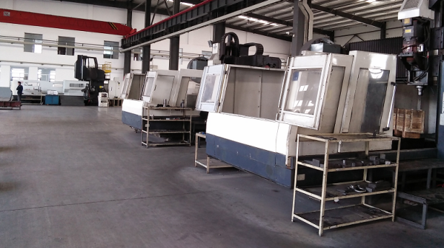
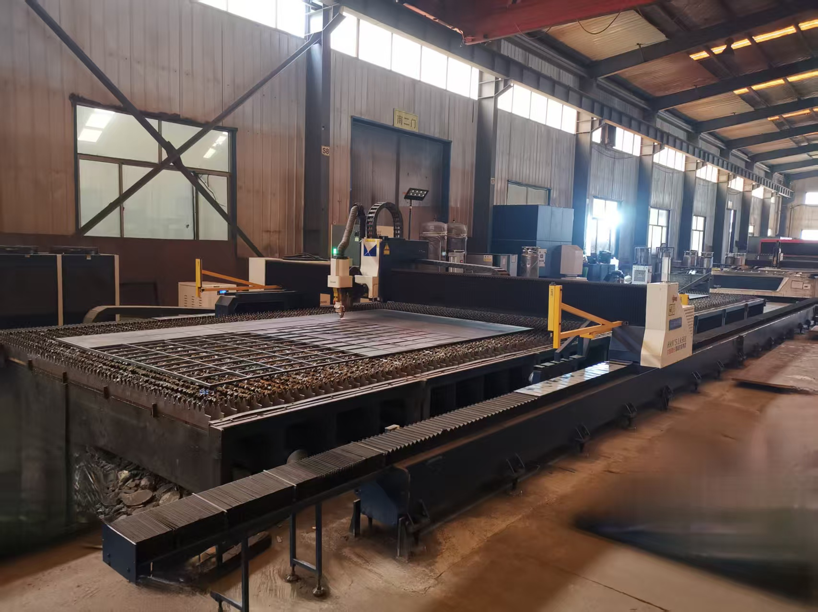
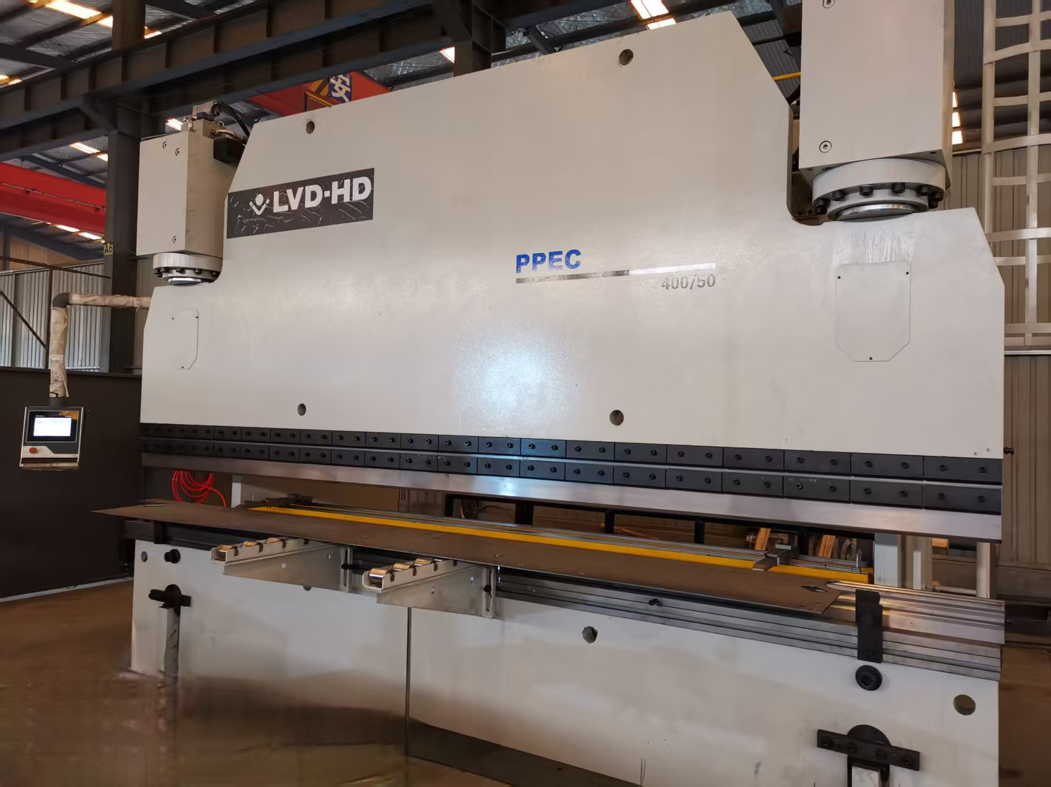
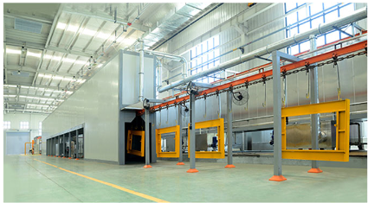
Strong manufacturing capabilities - professional production equipment
CNC processing equipment
Number of devices: 8 units
Purpose: Processing of chassis parts
Laser Cutting Machine
Number of devices: 5
Maximum equipment power: 20000W
Purpose: Processing of chassis parts
CNC Bending Machine
Number of devices: 3 units
Purpose: Processing of chassis parts
Powder Coating Line
Can meet customer color customization needs

Slide 14
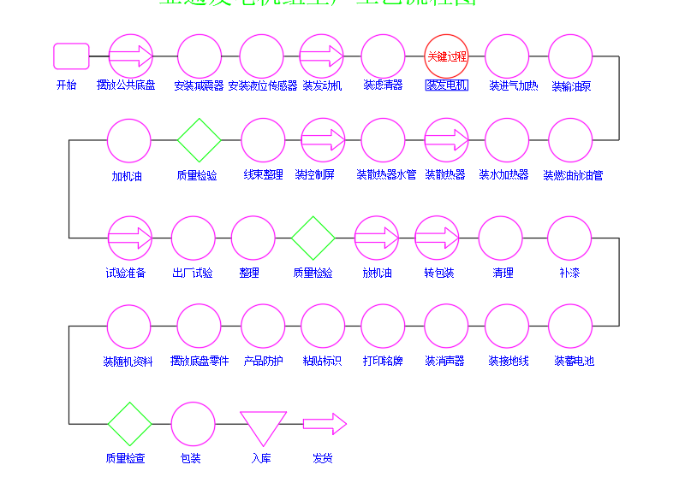
2. Generator set process flow
Key Process
Start
Place the common chassis
Install shock absorber
Install the night position sensor
Install Engine
Install Filter
Install Generator
Install Intake Heater
Install Fuel Pump
Control key links
Add Engine Oil
Quality Inspection
Harness Organization
Install control panel
Install the radiator water pipe
Install Radiator
Install water heater
Install the fuel drain pipe
Test preparation
Factory test
Tidying up
Quality Inspection
Drain engine oil
Repackaging
Clear
Touch-up painting
Install random materials
Place chassis parts
Product protection
Paste labels
Print nameplate
Install muffler
Install grounding wire
Install battery
Quality Check
Packaging
Warehousing
Shipping

Slide 15
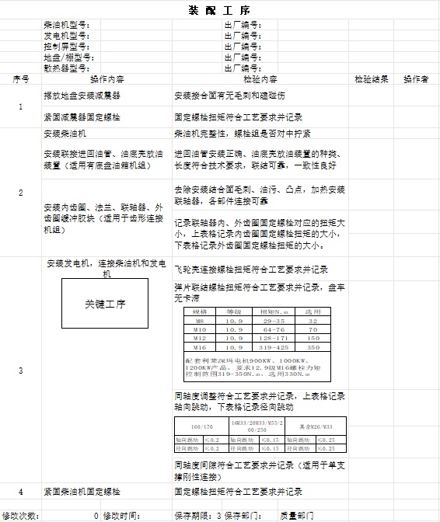
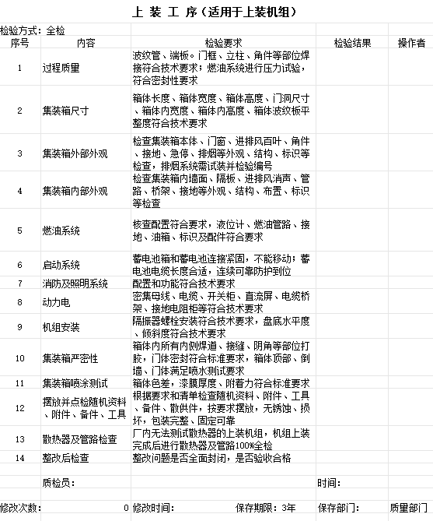
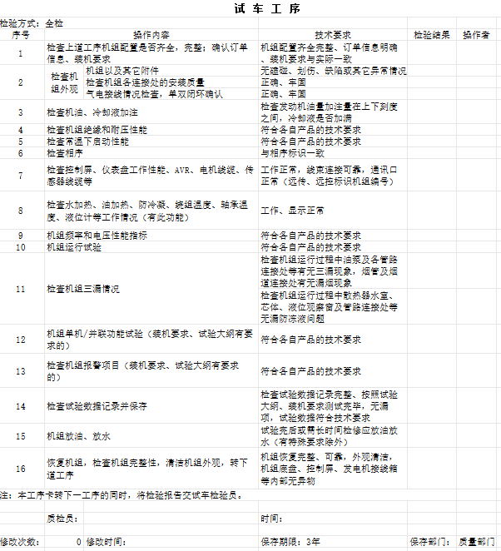
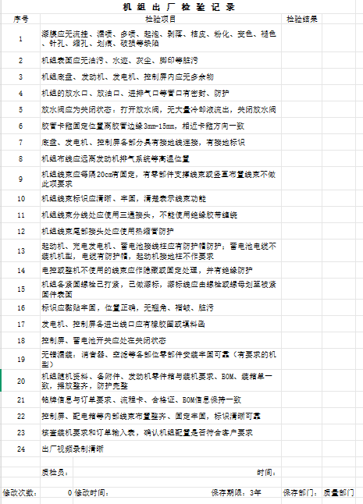
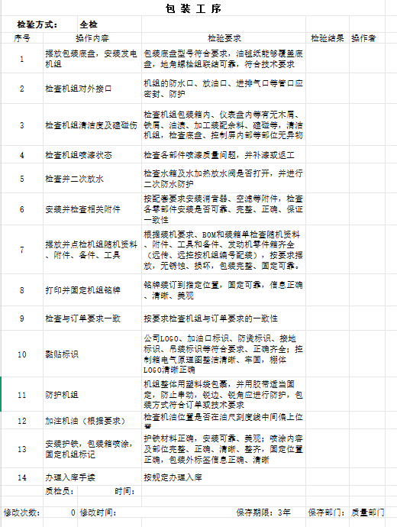
IV. High Quality
1. Quality management system - throughout the entire product process
Based on the characteristics of the generator sets industry, we have established a total process quality control, integrating comprehensive quality management into the entire life cycle of generator set production and manufacturing, to improve product quality.
Customer-centric
Planning process
Process management
Process improvement
Full participation
TQM
Comprehensive quality management

Slide 16
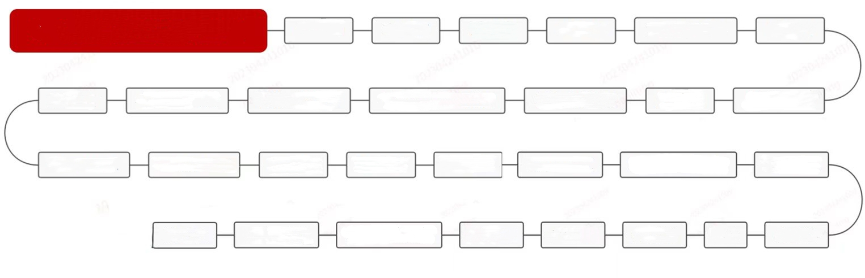







2.Strict supplier management system - ensuring the quality of parts and products
Xinyatong Supplier Quality Management System Evaluation
System Planning
Document Control
Record Control
Business Plan
Organizational Structure and Responsibilities
Management Review
Customer Satisfaction
Delivery and After-sales Service
Order and Contract Review
Tooling, Moulds, and Workstation Equipment Management
Facilities and Equipment Management
Work Environment
Human Resource Management
Product Design and Development
Process Design and Development
Procurement Management
Production and Manufacturing
Inventory Management
Control of Nonconforming Products
Monitoring and Measuring Equipment Management
Laboratory Management
Trade Security
Control of Nonconforming Products
Monitoring and Measurement of Products
Internal Audit
Risk Management
Data Analysis
Improvement
Quality Cost
High-quality Component Suppliers

Slide 17

V. Winning Service
One call from the customer, and we handle all the issues
Pre-sales: Provide guidance to help you choose the right product.
Pre-sales
After-sales
During sales: On-site service available, hands-on operation guidance.
During sales
After-sales: Service institutions nationwide, just one call away for help.

Slide 18

Summary
Xinyatong, backed by the comprehensive listed company Yatong Precision, has strong risk resistance capabilities and is the best partner for long-term cooperation.
The company has sufficient R&D investment and can continuously provide advanced products to customers.
Strict product quality management, ensuring peace of mind in purchase and ease of use.
Cooperation & Win-Win

